Slide 1
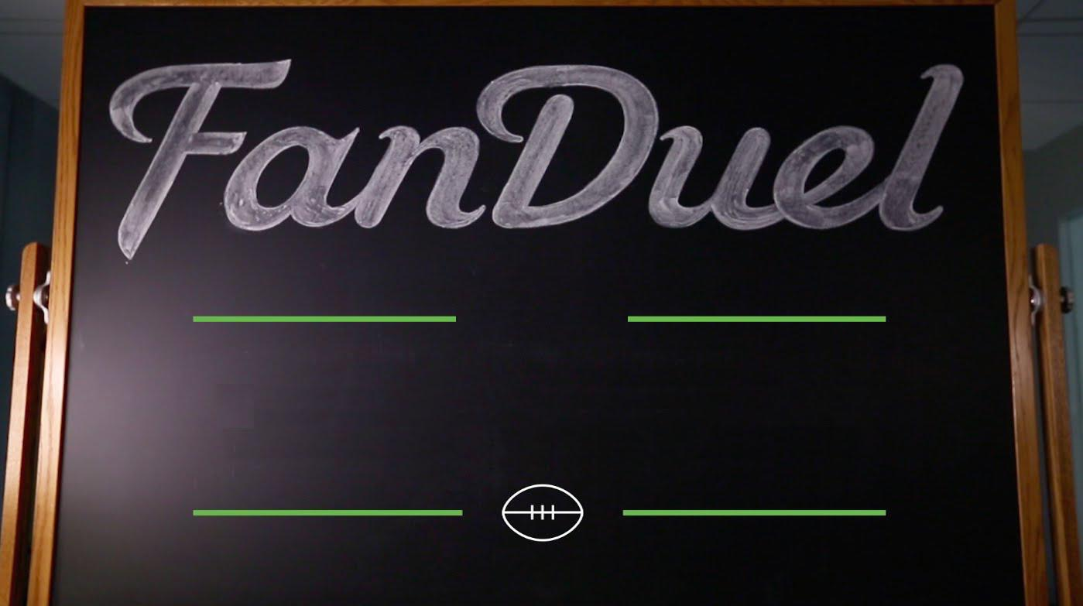
Fantasy Forecast
Weekly
By: Timothy Lagrimas

Slide 2
Problem?
Fantasy Forecast

Slide 3
Solution!
Fantasy Forecast

Slide 4
Overview
Fantasy Forecast
The final product consists of two parts: the statistical prediction software on the backend and the website for users to interact with it.
Statistical Prediction Software
FanDuel Lineup Optimizer
One-Week 10-Player Leagues
Entries up to $5,300
Winnings up to $25,000
Top 3 win cash prizes.

Slide 5
Assumptions
Fantasy Forecast
User compatibility:
Any OS with Google Chrome and Mozilla Firefox
Internet connectivity
General knowledge of Fantasy Football

Slide 6
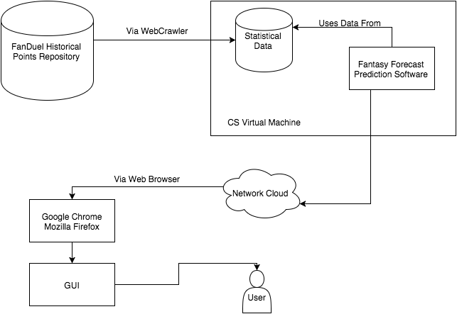
System Diagram
Fantasy Forecast

Slide 7
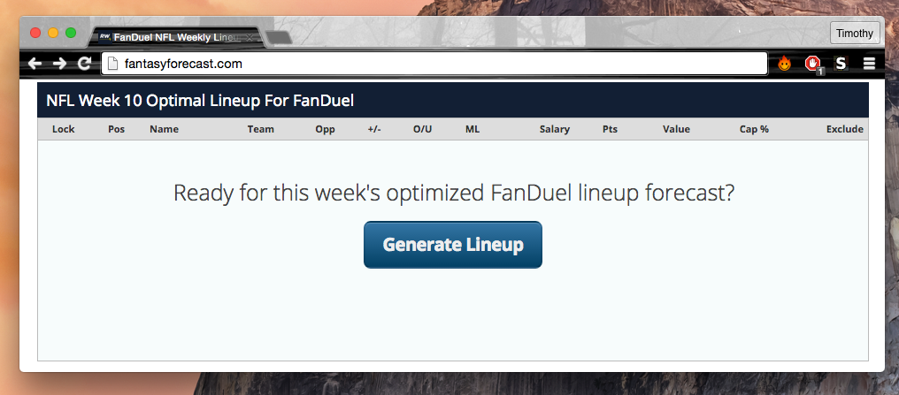
Main User Story
Fantasy Forecast
User goes to the Fantasy Forecast website.

Slide 8
Main User Story
Main User Story
Fantasy Forecast
Fantasy Forecast
User presses the “generate lineup” button

Slide 9
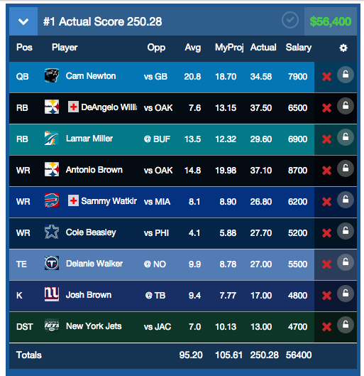
Main User Story
Fantasy Forecast
User is presented with a lineup

Slide 10
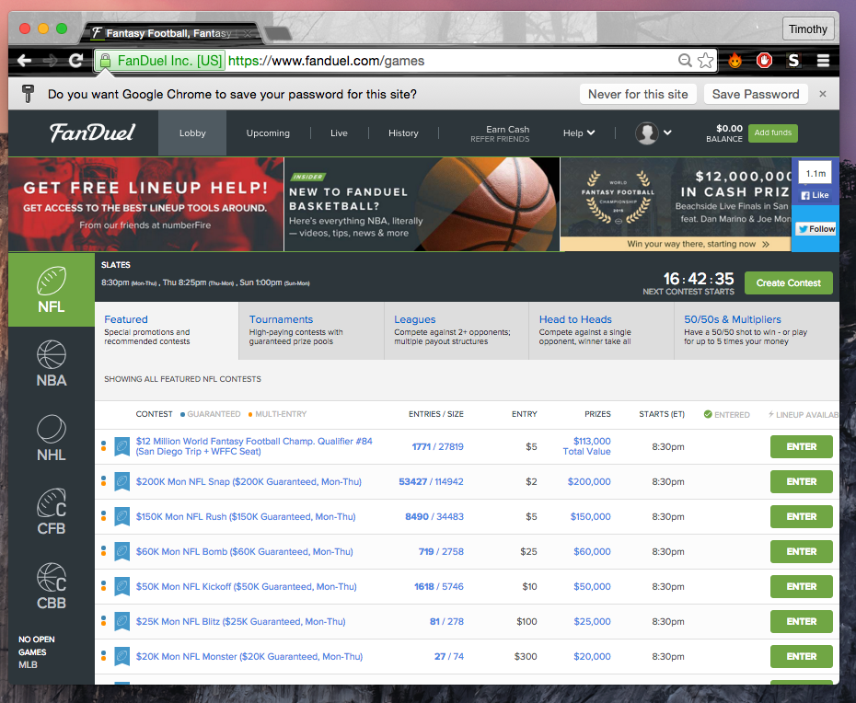
Main User Story
Fantasy Forecast
User goes to the NFL league table

Slide 11
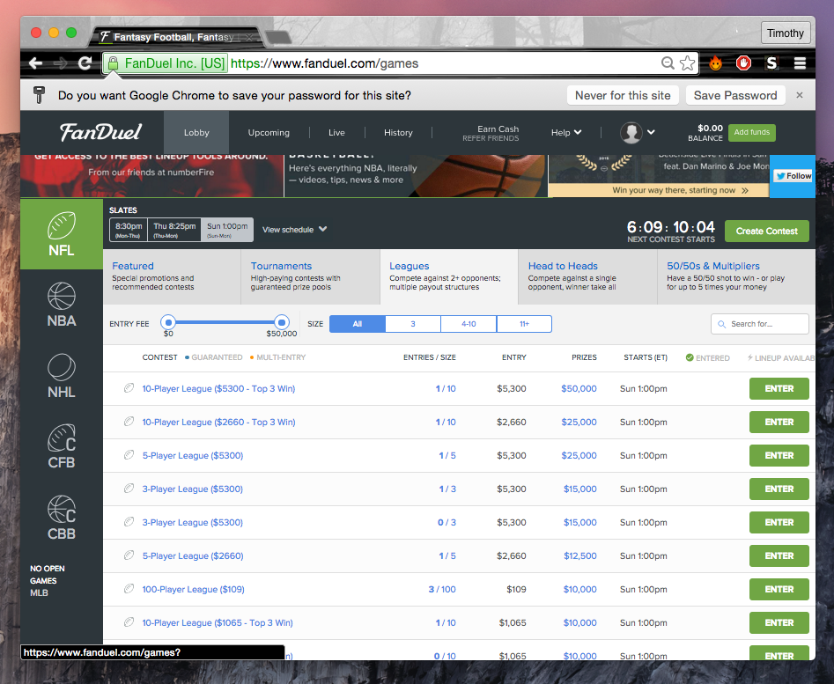
Main User Story
Fantasy Forecast
User enters a contest

Slide 12
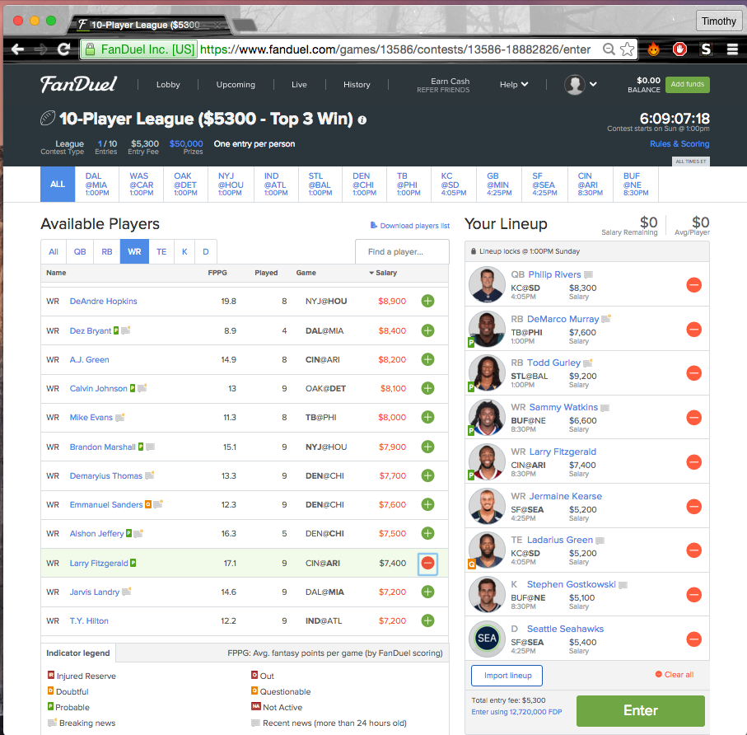
Main User Story
Fantasy Forecast
User inputs the generated lineup for the respected week into FanDuel

Slide 13
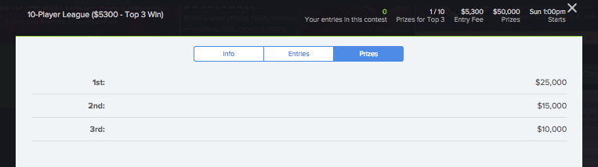
Main User Story
Fantasy Forecast
If the user finishes in the top 3, they win real money instantly!

Slide 14
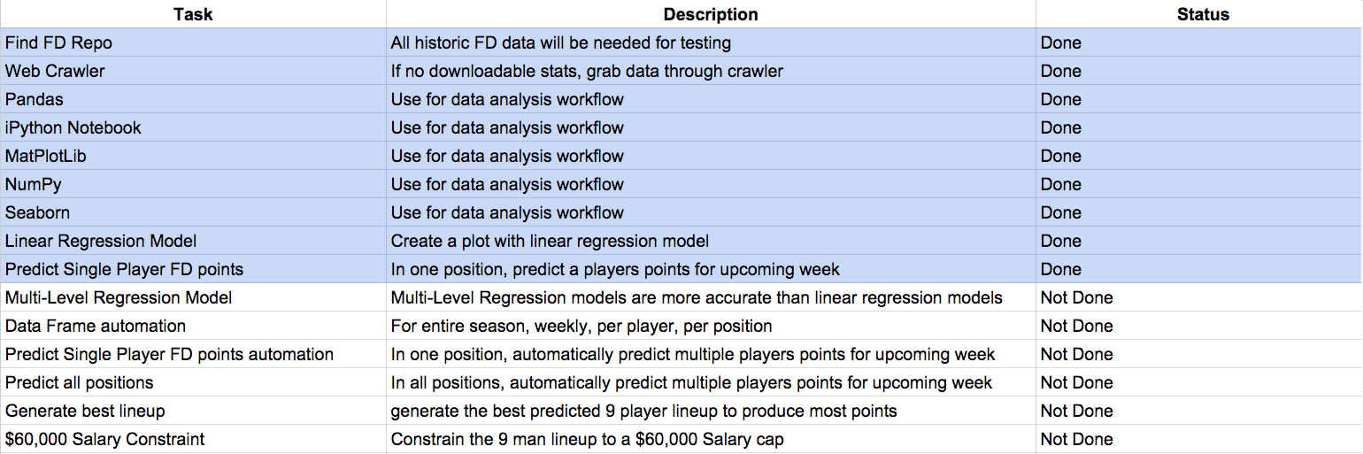
Completed and Future Work
Fantasy Forecast

Slide 15
Fantasy Forecast
Stay safe out there! Keep up with your weekly Fantasy Forecast!

